Slide 1

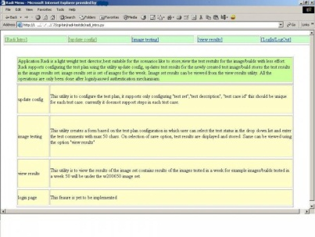

Tools for Management of Testing and Tests
Stoimen Stoimenov
QA Engineer
SitefinityLeads,SitefinityTeam6
Telerik QA Academy

Slide 2

Table of Contents
Test Case Management Systems (TCMS)
TestLink
General Information
Other Tools for test management
Microsoft Test Manager
Test Director
Custom Made TCMS

Slide 3
Test Case Management Systems (TCMS)

Slide 4

TCMS
What are Test Case Management Systems?
Software used to manage tests (automated or manual)
Often associated with automation software
Often include requirement and/or specification management modules

Slide 5
TestLink

Slide 6
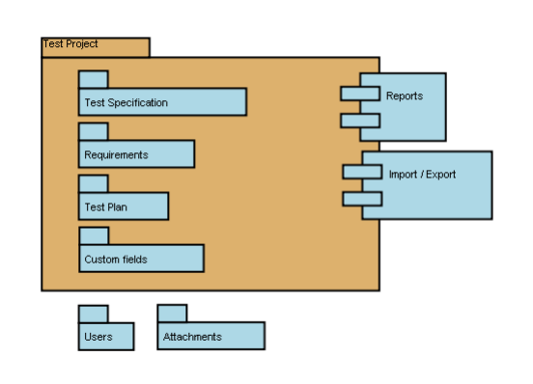
TestLink
What is TestLink?
A web based Test Management system
Overall structure - TestLink has three cornerstones:
Test Project
Test Plan
User

Slide 7

Useful Links
Try an online demo of TestLink here:
http://testlink.sourceforge.net/demo/login.php
User manual:
http://www.teamst.org/index.php/doc

Slide 8
Basic Terminology (1)
Test Case
Describes a testing task via steps (actions, scenario) and expected results
Test Suite
Organizes Test Cases to units
Test Plan
Created when you'd like to execute Test Cases
Includes builds, milestones, user assignment and test results

Slide 9

Basic Terminology (2)
Test Project
Includes Test Specification with Test Cases, Requirements and Keywords
User
Defines available TestLink features for a user

Slide 10
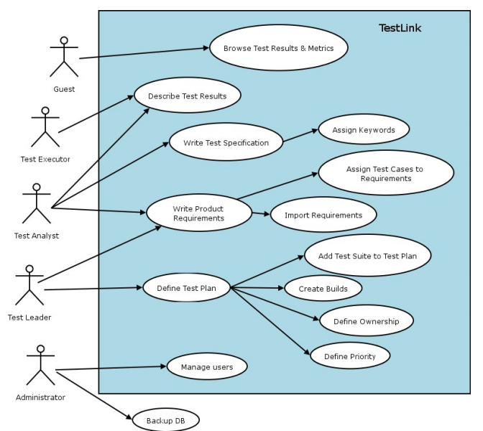
Example of TestLink simple work-flow
Demo

Slide 11
Test Projects
Test Projects are the basic organizational unit of TestLink
Could be products or solutions
May change their features and functionality over time
But for the most part remains the same
Test Projects are independent and do not share data
A single test project should be used for a team/product

Slide 12

Test Specification
Test Specification's structure is broken down into Test Suites and Test Cases
One test Project has just one Test Specification

Slide 13
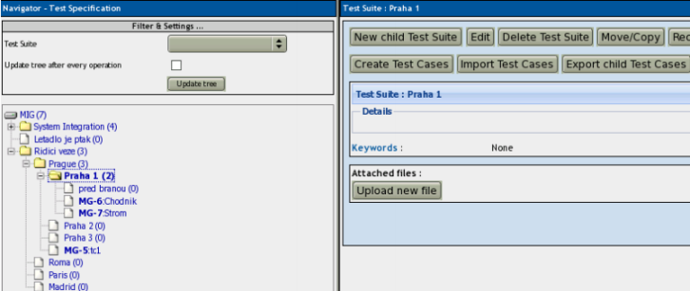
Test Suites (1)
Test cases are organized into test suites
Test suites consist of:
Title
Description
Test cases
Other test suites (possibly)

Slide 14

Test Suites (2)
Test suites may contain:
Scope of included tests
Default configuration
Preconditions
Links to related documentation
List of tools
Infrastructure overview
Etc.

Slide 15
Test Cases
What is a test case?
A set of inputs, execution preconditions, and expected results (outcomes)
Test cases have the following parts:
Identifier
Title
Summary
Steps
Expected results
Attachments
Importance
(High / Medium / Low)
Execution type
(Manual / Automated)
Custom fields

Slide 16

Test Case - Active Attribute
Test cases have an "Active" attribute
Useful when a test case is still in development
The test designer can decide when to set it available for use

Slide 17
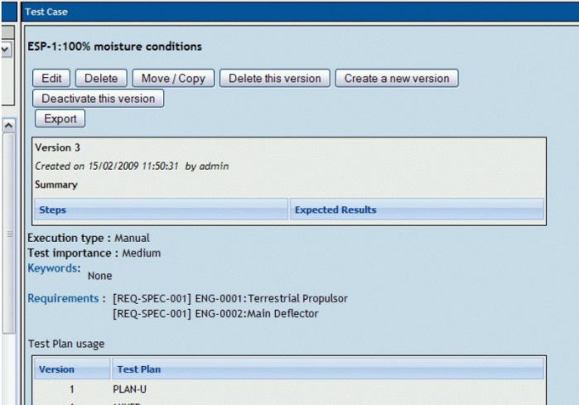
Requirements Relation
Test cases could be related to software/system requirements
TestLink allows assigning test cases to particular test plans for execution

Slide 18

Keywords
Keywords give users another level of depth when categorizing Test Cases
Useful for categorizing and filtering

Slide 19
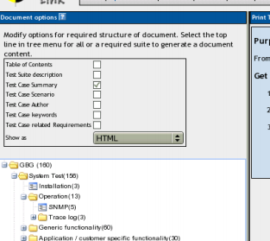
Generate Test Specification Document
Users can generate the current Test specification as a document
Could be generated for the whole content or for a particular test suite

Slide 20

Requirements Based Testing

Slide 21
Requirements Based Testing
One or more test cases could be designed for every requirement
A combination of risk- and requirements-based testing could have some advantages:
Revealing missing requirements
Focus on the most important part of the system
Better communication with users and stakeholders
Easier negotiation and prioritization

Slide 22
Requirements Specification Document
Requirements are grouped to one or more System/Software/User Requirement Specifications
1
includes
Product
1
*
1
Requirements Specification
Test Specification
includes
1
1
*
*
Requirement
*
covers
Test Case
*

Slide 23
Test Plans
Test Plans are the basis for test execution activity
Test Plans include:
Name
Description
Collection of chosen Test Cases
Builds
Test Results
Milestones
Tester assignment
Priority definition

Slide 24
Test Plan Description
Description should include:
Summary / Scope
Features to be tested
Features to not be tested
Test criteria (to pass tested product)
Test environment, Infrastructure
Test tools
Risks
References

Slide 25


Deleting Test Plans
Deleting a test plan should be done with caution
All corresponding data gets deleted too
E.g., test cases, results, etc.

Slide 26
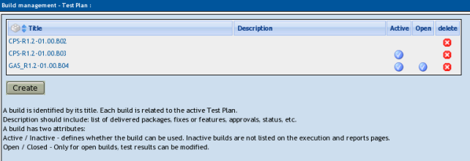
Build Management
Executing a test case/suite requires a build to be available for the project

Slide 27
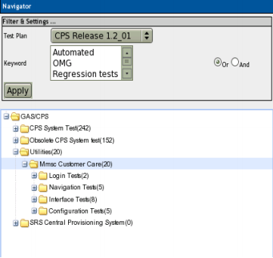
Test Sets
A test plan is defined by adding a test set (of test cases) from Test Specification
A particular version of a test case gets assigned to a test plan
Test sets allow modifying the execution order of test cases

Slide 28
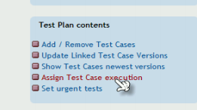
Test Execution Assignment
TestLink allows assigning test case execution to different users
A user can track the test cases assigned to him and the metrics of his tests

Slide 29
Test Execution
Test execution is available after:
A Test Specification is written
A Test Plan is created
Test Cases are added into Test Plan
At least one Build is created
Testers have appropriate rights for execution to work with the this Test Plan

Slide 30
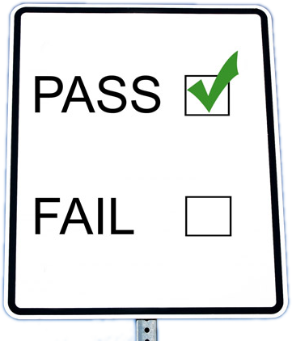

Test Status
Test execution results in labeling test cases as:
Pass
Fail
Blocked (impossible to test for some reason)

Slide 31
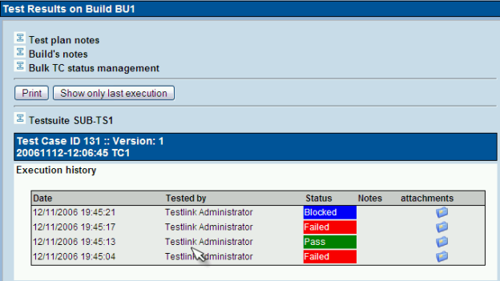
Test Execution and Results
Demo

Slide 32

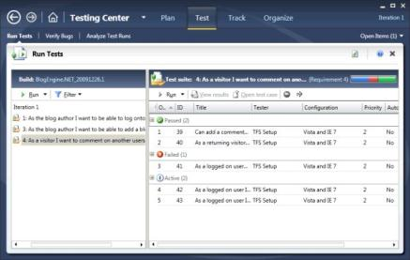
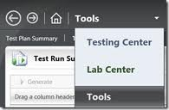
Microsoft Test Manager

Slide 33
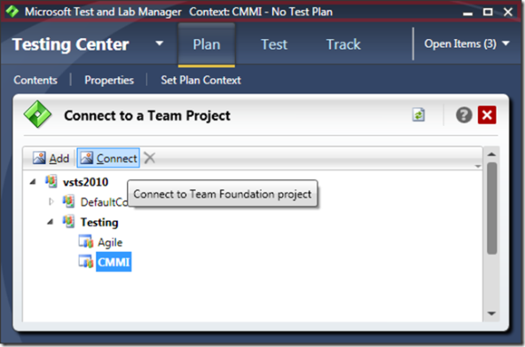
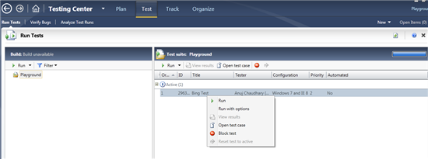
Microsoft Test Manager
Microsoft Test Manager allows:
Test Planning
Test Case Management
Running Manual Tests
Works with TFS

Slide 34
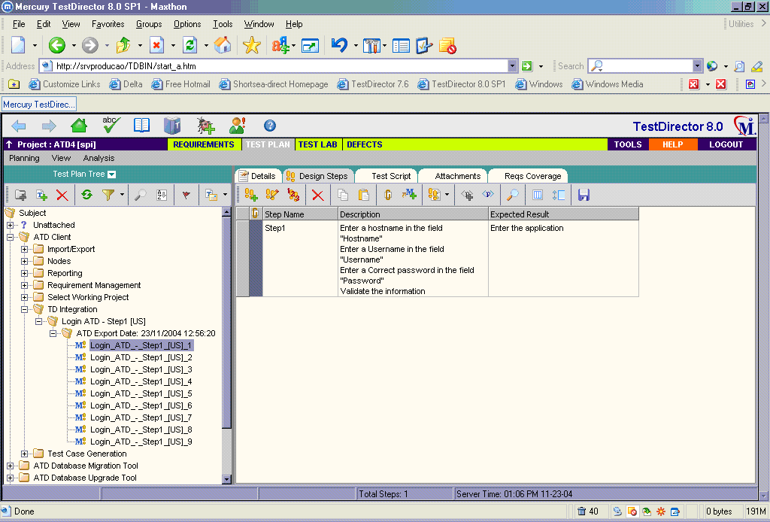
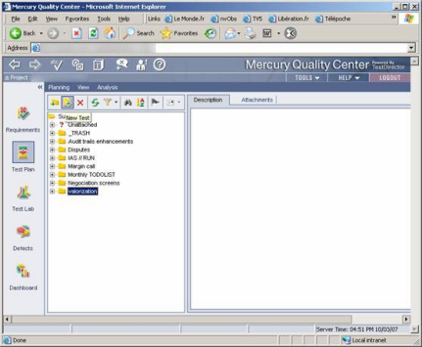
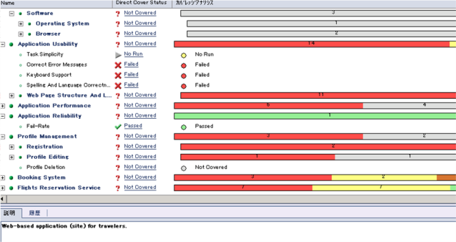
Test Director

Slide 35
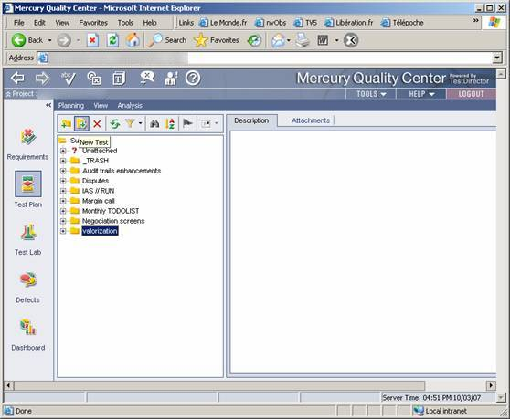
Test Director
Test Director is currently available as a plug-in for Mercury Quality Center
Works on any browser that supports ActiveX technology
Test Director has four modules:
Requirements
Test Plan
Test Lab
Defects

Slide 36
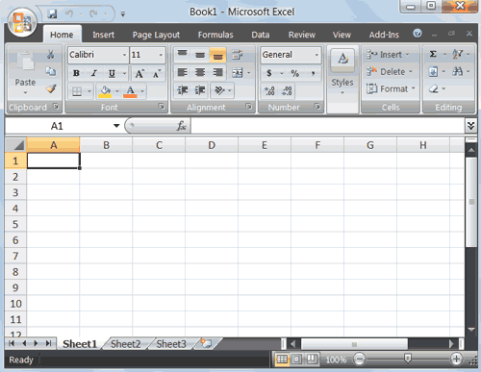
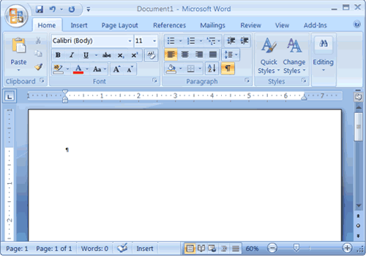
Custom Made TCMS
How can we make our own TCMS?
Demo

Slide 37
Tools for Management of Testing and Tests
?
?
?
?
?
Questions?
?
?
?
?
?
?

